Slide 1
Trade Studies Presentation
Computations & Communications (C&C)

Slide 2
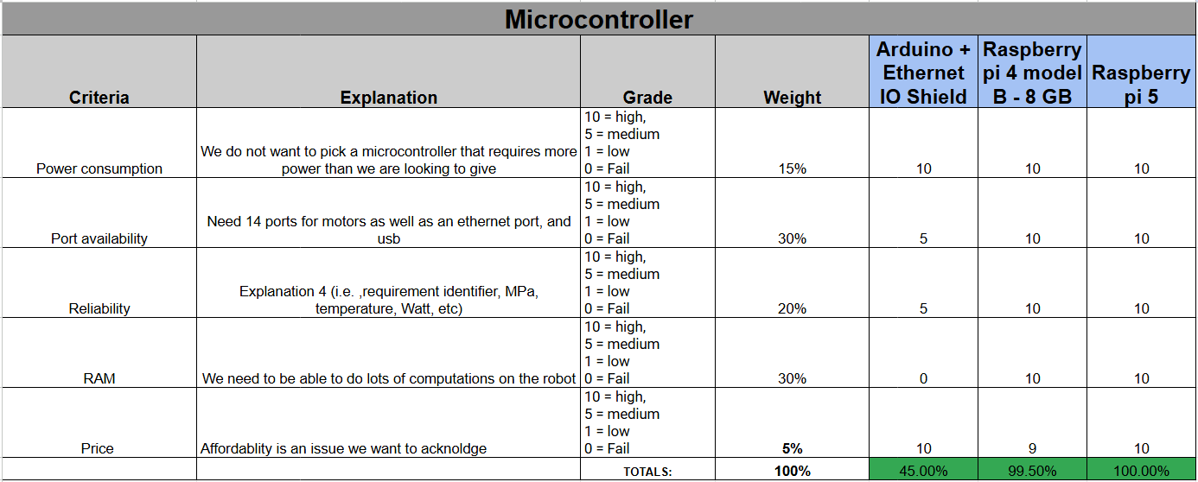
Microcontroller
Notes:
It’s over Vecna, we are the Stranger Things.

Slide 3
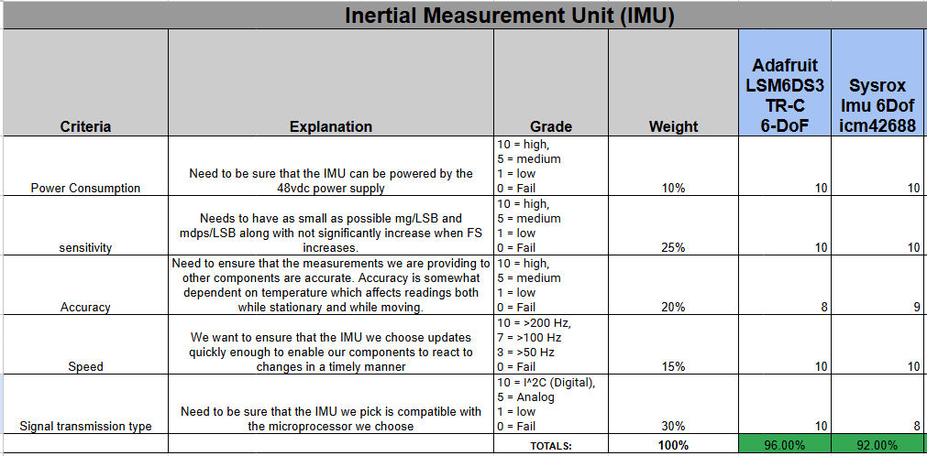
6 DOF IMU

Slide 4
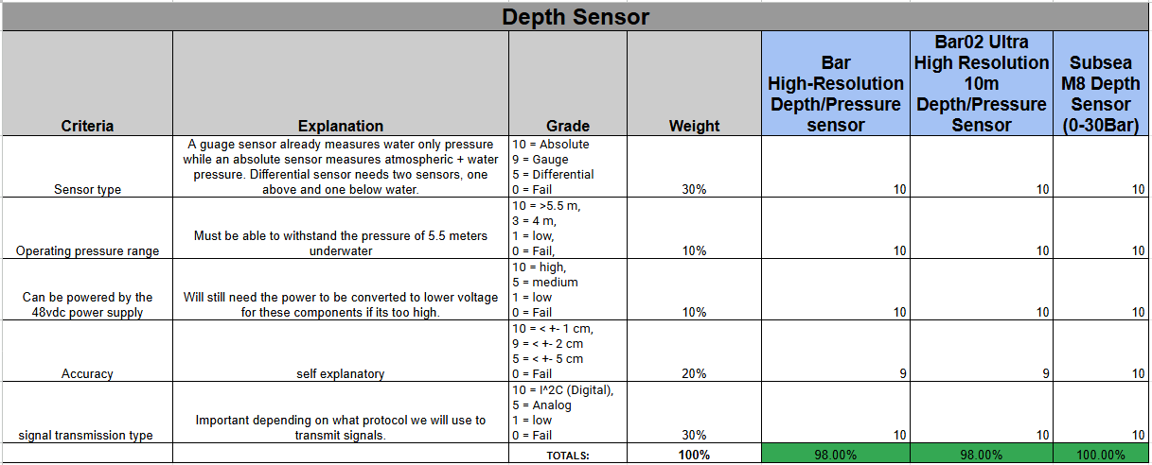
Depth Sensor

Slide 5
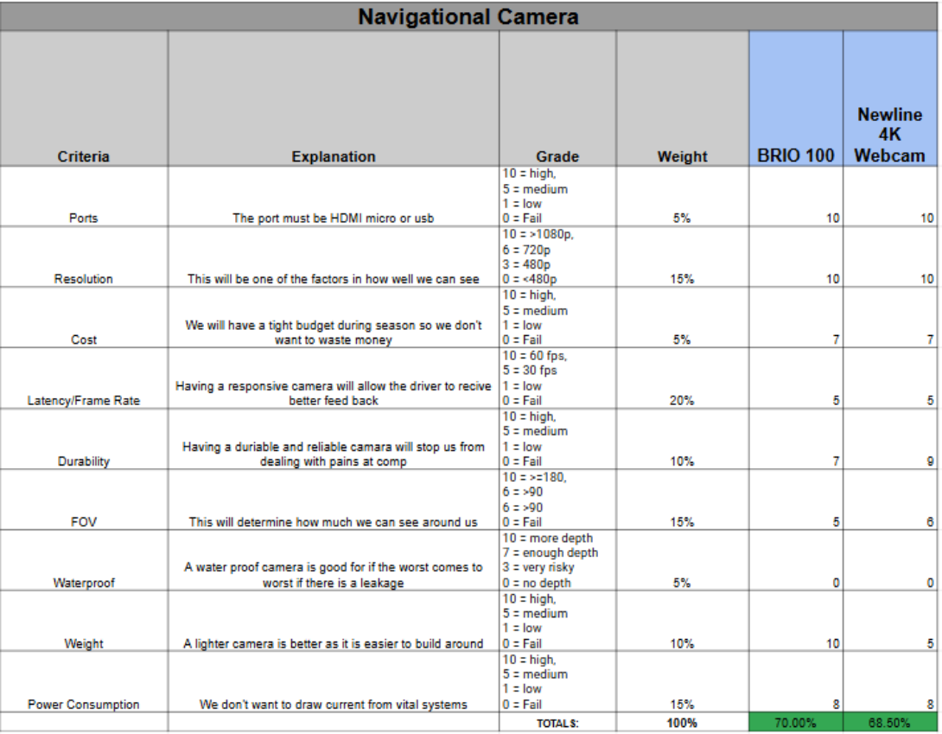
Navigational Camera

Slide 6
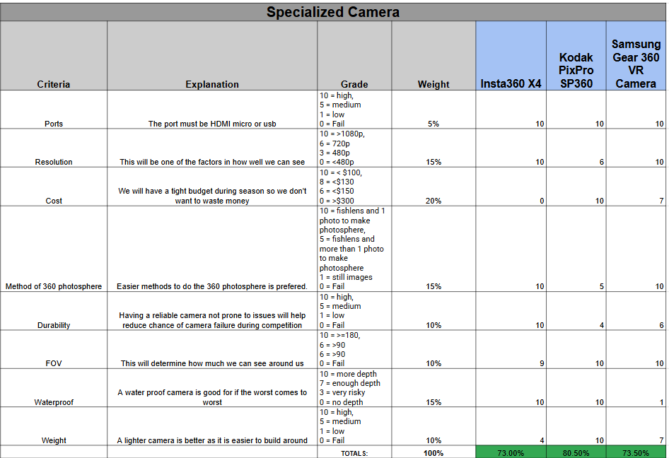
“Specialized” Camera

Slide 7
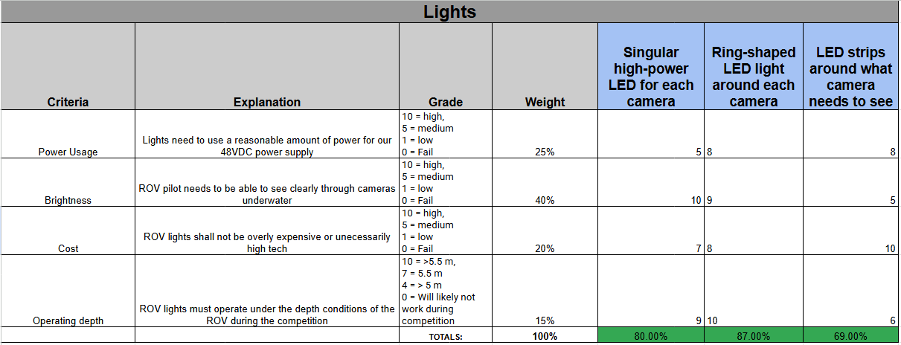
Lights

Slide 8
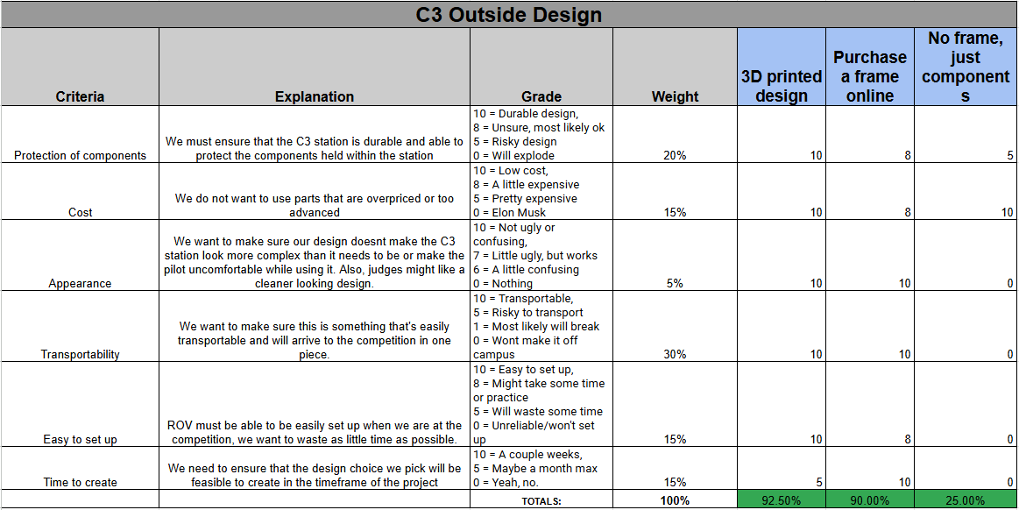
C3 Station Outside Design

Slide 9
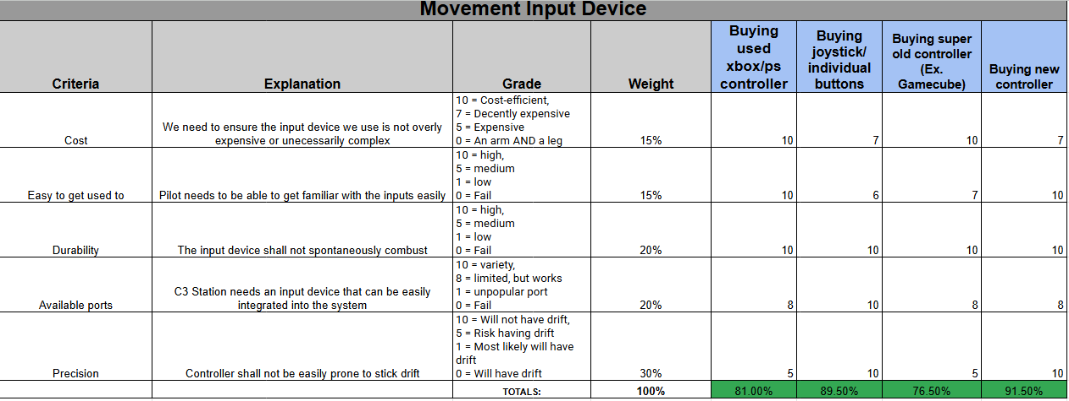
C3 Station Movement Input Device

Slide 10
Any Questions?

